Slide 1
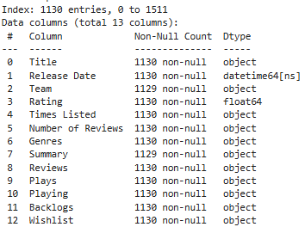
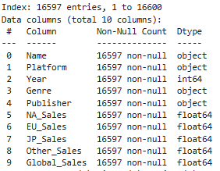
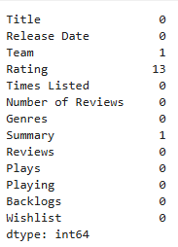
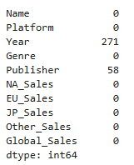
Data Cleaning
2 Datasets Shape:
df1 = Games.csv – 1512 rows and 13 columns
df2 = Vgsales.csv – 16598 rows and 10 columns
Duplicates
In df1 we have 382 duplicates
In df2 we have 1 duplicate
Null values:
Handled null values:
Used median in Rating and Year and
Unknown for Publisher
Team Goggled and replaced the null value
Data types:
Data type is object for most of the columns in df1 as K is determined as alphabet the columns are treated as object so changed k to 1000 by replacing ‘k’ with 'e+03‘
Changed data type of Times Listed, Number of Reviews, Plays, Playing, Backlogs and Wishlist
After changing Release Date to Datatime data type, 3 TBD values are found .As we have only 3 missing values in release dates, I googled the dates and enter them individually.
In df2 changed Year data type to integer
In df1 Team and Genres are give as list , so exploded both

Slide 2
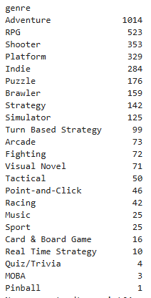
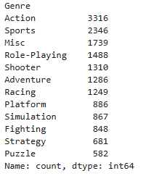
Data Cleaning - 1
df1
df2
Generalized Genre
Action - Brawler, Arcade
Sports – Sport
Misc – Indie, Music, Quiz/Trivia, Pinball, Nan
Role-Playing – RPG
Shooter – Shooter
Adventure – Adventure, Visual Novel, Point-and-Click
Racing – Racing
Platform – Platform
Simulation – Simulator
Fighting – Fighting
Strategy – Turn Based Strategy, Strategy, Card & Board Game, Tactical, MOBA, Real Time Strategy
Puzzle - Puzzle
Genres: we have 12 in df2 , 23 in df1. So generalized df1 and changed genres to they respective Genre without loosing data
After cleaning
In df1 – 4822 rows and 13 columns
In df2 – 16597 rows and 10 columns

Slide 3
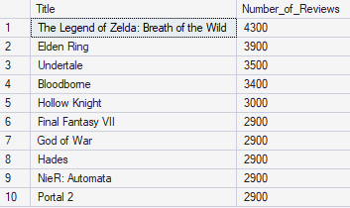
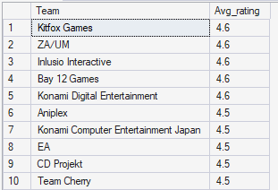
EDA – Games dataset
1. What are the top-rated games by user reviews?
2. Which developers (Teams) have the highest average ratings?
High Player Volume
Strong Visibility & Marketing
Longevity
Platform Effects
It Does Not Automatically Mean “Best” but Is very popular and Has high player engagement
Highest number of reviews = strongest player reach and engagement.
Highest average rating of a developer/publisher = strong overall quality reputation and consistent execution.
Highest rating = strongest satisfaction (relative to number of reviewers)

Slide 4
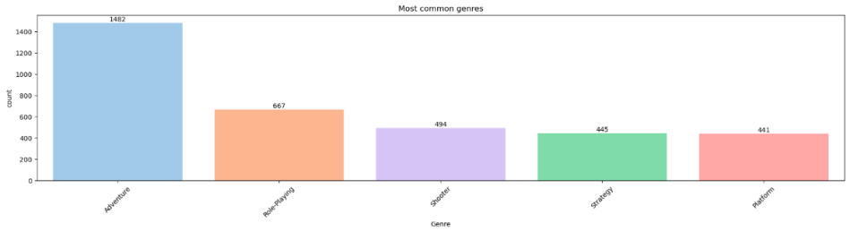
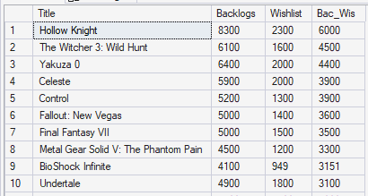
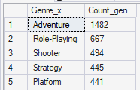
EDA – Games dataset (1)
3. What are the most common genres in the dataset?
4. Which games have the highest backlog compared to wishlist?
It shows what type of games are most represented or most popular in quantity.
Many developers are creating games in that genre
That genre sells well
Players demand more of that type
Wishlist → People want to play it (interest)
Backlog → People own it but haven’t played or finished it (delayed action)
Strong purchasing behavior
Lower immediate play priority
Potential “overbuying” trend

Slide 5
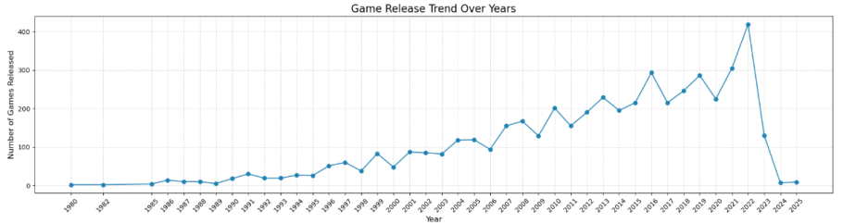
EDA – Games dataset (2)
5.What is the game release trend across years?
We can see very low releases from 1980 to 1995 only dozens of games per year, it started to accelerate from 2000 with hundreds of releases from 2005+ and Rapid growth was there from 2010 to 2021.
Several spikes (2015, 2018, 2020)
Peak around 2022 (~420 games released)
2023 shows a major drop (~130)
2024–2025 extremely low
Important: This is most likely due to: Incomplete data for recent years, Not a real industry collapse

Slide 6
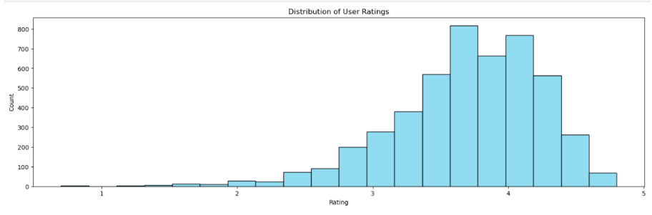
EDA – Games dataset (3)
6. What is the distribution of user ratings?
Ratings Are Heavily Concentrated between 3 and 4
Rating (3-4) (~56%) dominates.
Rating Group 4 (~34%) is the second largest.
Lower rating groups (0–2) together make up less than 10%.

Slide 7
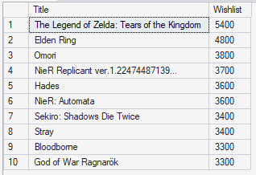
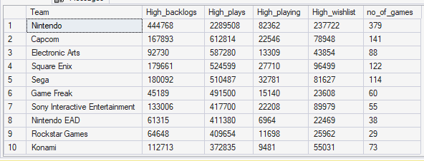
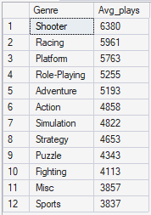
EDA – Games dataset (4)
7. What are the top 10 most wishlisted games?
9.Which developer studios are the most productive and impactful?
8.What’s the average number of plays per genre?
High Wishlist Indicates strong consumer anticipation and future purchase intent. leading indicator of market demand.
It measures engagement intensity
High average plays per genre = high engagement and replayability. Low average plays per genre = shorter or one-time experiences.
A Studio is most productive → many games exist (high backlog, high release count).
A Studio is most impactful → their games are widely played, actively engaged with, or highly anticipated (plays, playing, wishlist).

Slide 8
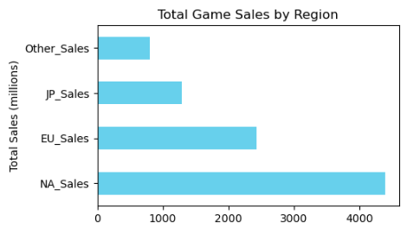
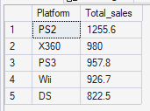
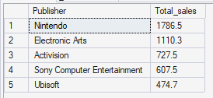
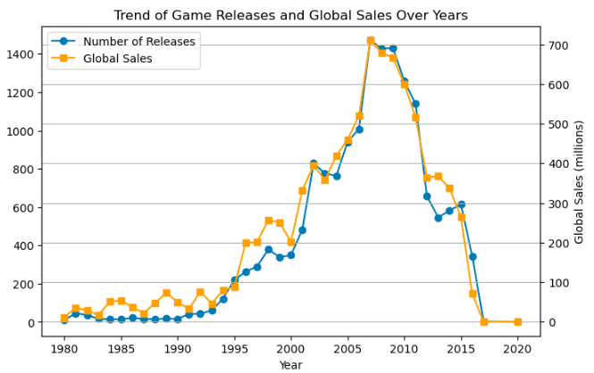
EDA – Vgames dataset
10.Which region generates the most game sales?
11. What are the best-selling platforms?
13. Who are the top publishers by sales?
12. What’s the trend of game releases and sales over years?
Strong Growth Phase (Mid-1990s to 2008)
Peak activity occurred around 2008–2009, with:
~1,400+ game releases
~700+ million in global sales
Sharp Decline After 2010
The steepest fall appears between 2011–2015.
This does not necessarily mean the gaming industry declined, but rather that the dataset likely tracks traditional console/retail sales.
Strong positive correlation (1995–2008).

Slide 9
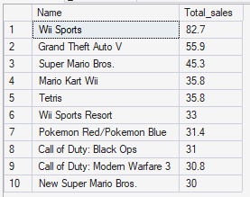
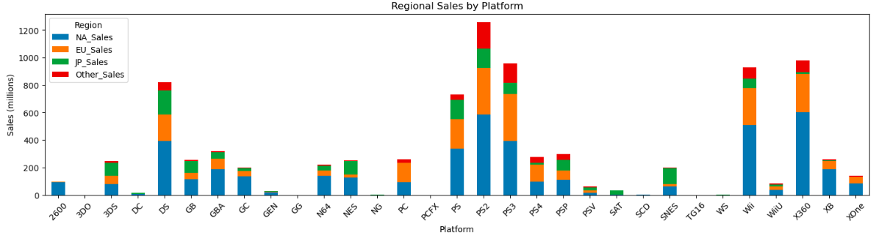
EDA – Vgames dataset (1)
14. Which games are the top 10 best-sellers globally?
Best-Selling Platforms Overall
The highest total sales come from: PS2 – Dominant leader, X360,Wii, PS3
2. North America Is the Largest Market : Across almost all major platforms
NA contributes the largest share of sales.
Especially dominant for: X360, PS2
3. Europe Closely Follows North America
4. Japan Shows Platform-Specific Strength
15. How do regional sales compare for specific platforms?

Slide 10
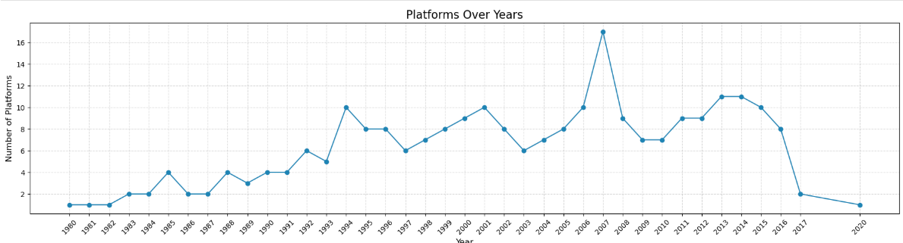
EDA – Vgames dataset (2)
16. How has the market evolved by platform over time?
The number of platforms steadily increased from 1980 to the mid-1990s.
Growth accelerated in the early 2000s, leading to a peak around 2007.
The highest number of platforms occurs in 2007.
After 2007, the trend generally declines with some fluctuations.
A sharp drop is visible after 2016, indicating strong market consolidation.

Slide 11
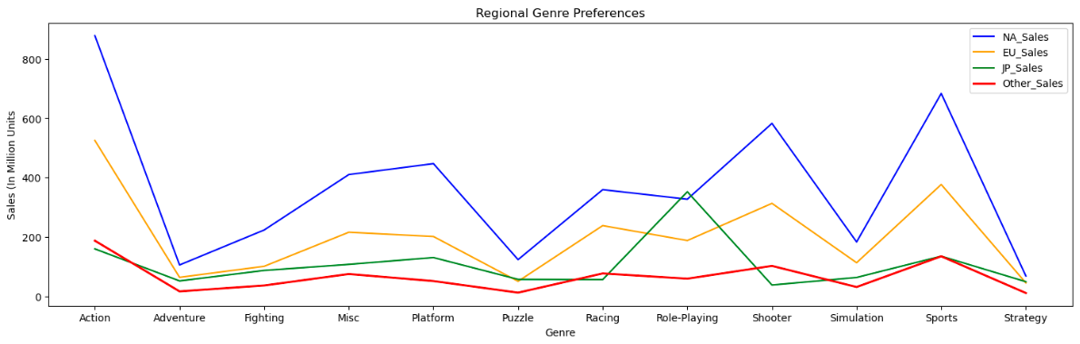
EDA – Vgames dataset (3)
17. What are the regional genre preferences?
North America Dominates Overall Sales
NA leads in almost every genre.
Especially strong in: Action, Sports, Shooter, Platform
Europe Mirrors North America (But at Lower Scale)
EU follows similar genre patterns to NA.
Strong in: Action, Sports, Shooter, Racing
Japan Strongly Prefers Role-Playing Games (RPGs)
JP peaks dramatically in Role-Playing.
Much weaker in: Shooter, Sports, Simulation
Overall Market Conclusion
NA = Largest revenue driver
EU = Similar to NA but smaller
JP = Distinct taste profile (RPG-focused)
Action = Globally dominant genre
Genre success depends heavily on regional culture

Slide 12
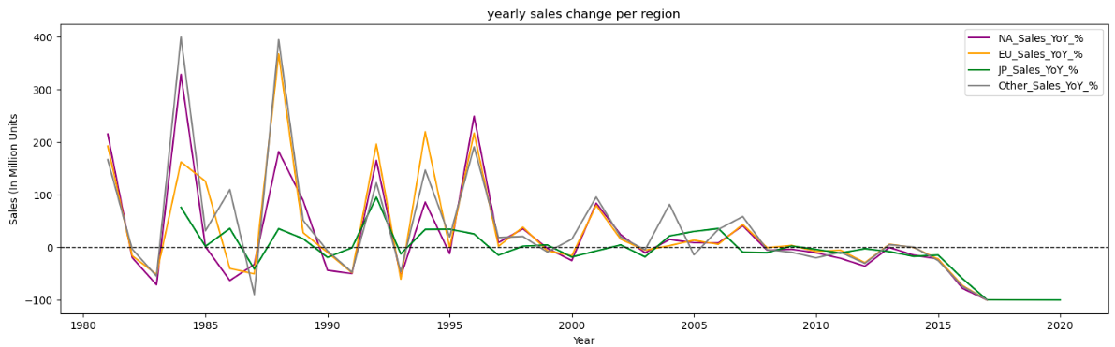
EDA – Vgames dataset (4)
18. What’s the yearly sales change per region?
Extremely High Volatility in Early Years (1980s–mid 1990s)
Very large spikes (some reaching 300–400% growth).
Sharp drops immediately after big spikes.
Peak Expansion Period Around Mid-1990s
Multiple regions show strong synchronized spikes.
NA and EU appear to move closely together.
Stabilization After Early 2000s
Volatility significantly reduces.
Most YoY changes stay within ±50%.
Movements become more gradual.
Strong Regional Correlation
NA and EU trends closely mirror each other.
JP appears more moderate and sometimes diverges.
“Other” region shows higher volatility in early years.
Consistent Decline Around 2016–2018
All regions show synchronized negative growth.
Drop approaches -100% toward the end.
🔎 Interpretation:
Industry contraction phase.
Possibly transition to digital sales not captured in dataset.
Or dataset ends and trailing years have incomplete data.
Western markets behave similarly.
Japan may have different consumer behavior or platform preferences.

Slide 13
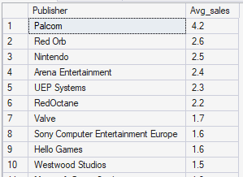
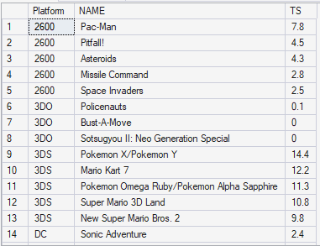
EDA – Vgames dataset (5)
19. What is the average sales per publisher?
20. What are the top 5 best-selling games per platform?

Slide 14
Merging data and Cleaning
Joined df1 and df2 on Title and name using Inner join and named it as df3
Df3.shape – (3829 ,23)
Replaced 'unknown‘ values in publisher with the value from team column
We have 4 different titles with unknown publisher which contains 24 rows
In Team column we had publisher and developer combined so if we know the publisher for 4 games we can remove rows with developer
Based on those 4 titles we know that ["NIS America","Atlus USA","Sonic Team","Headup Games"] are developers so I dropped rows where team is ["NIS America","Atlus USA","Sonic Team","Headup Games"]
Combining 2 genre column using ‘,’
Created new dataset df4 with required columns (3704)
Exploding genre_combined column
Stripping spaces after exploding
Removing duplicates
Df4 shape – (2228,17)
In SQL – (2321,17)

Slide 15
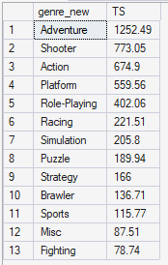
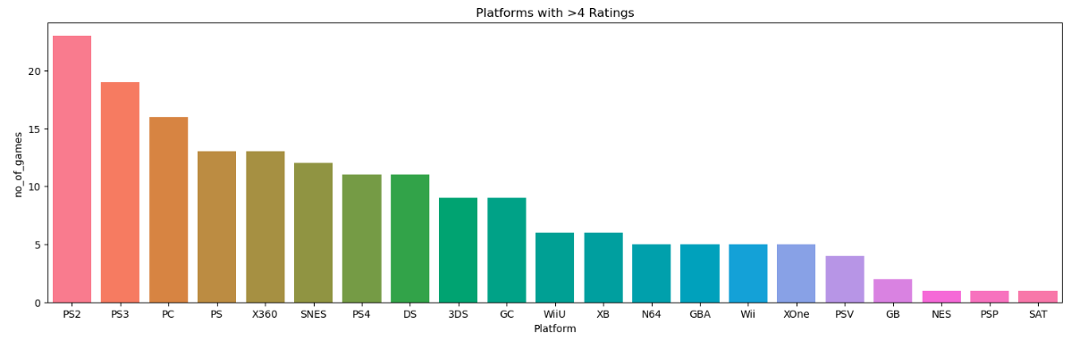
EDA Merged data
21. Which game genres generate the most global sales?
23.Which platforms have the most games with high ratings (e.g., above 4)?

Slide 16
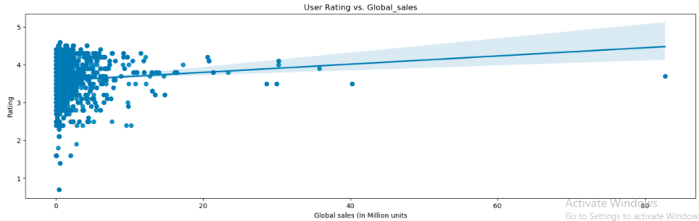
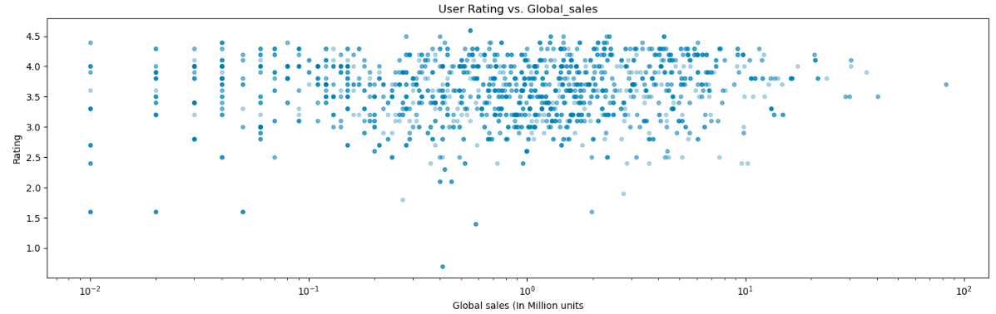
EDA Merged data
22. How does user rating affect global sales?
Weak Positive Correlation
There is a slight upward trend, meaning higher-rated games tend to sell more — but the relationship is weak. Rating alone does not strongly predict sales.
Sales Are Highly Skewed
Most games:
Sell under ~5 million units
Have ratings between 3–4.5
High Rating ≠ Guaranteed High Sales
Many games rated 4+ still have low sales. Low Ratings Rarely Become Best Sellers
Very low-rated games (<2) almost never reach high sales, suggesting poor quality limits extreme commercial success.

Slide 17
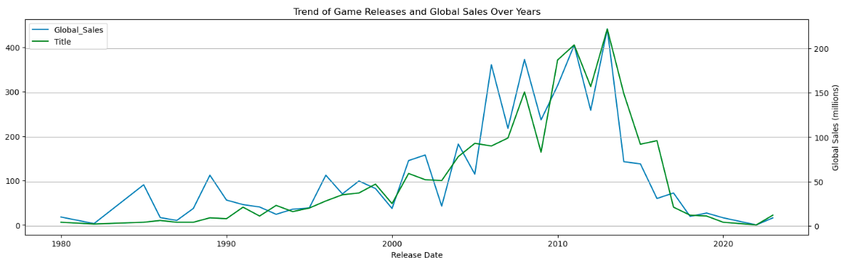
EDA Merged data (1)
24. What’s the trend of releases and sales over time?
Strong growth and peak in late 2000s–early 2010s: Both global sales and the number of games released increased significantly from the mid-1990s, peaking around 2008–2012. Global sales show sharper spikes than releases, indicating a few blockbuster years drove disproportionately high revenue.
Sharp decline after 2012: Following the peak, both metrics dropped noticeably, with global sales falling more steeply than the number of releases. This suggests reduced overall market revenue despite continued game production, possibly due to market saturation or industry shifts (e.g., digital/mobile transitions).

Slide 18
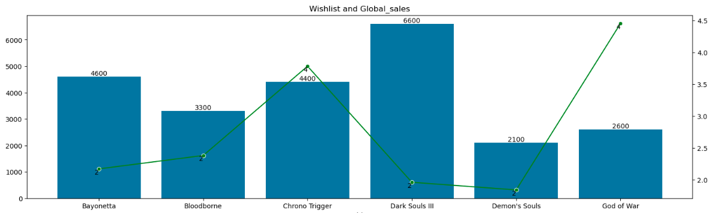
EDA Merged data (2)
25. Do highly wishlisted games lead to more sales?
Higher wishlist doesn’t always mean higher sales: Although Dark Souls III has the highest wishlist count (~6600), its global sales (~2M) are lower than God of War, which has fewer wishlists (~2600) but the highest sales (~4.5M). This suggests strong brand power and broader market appeal can outperform pre-release interest.
Strong alignment in some cases: Chrono Trigger shows both relatively high wishlist (~4400) and strong sales (~4M), indicating that for certain titles, higher consumer anticipation closely translates into higher global sales.

Slide 19
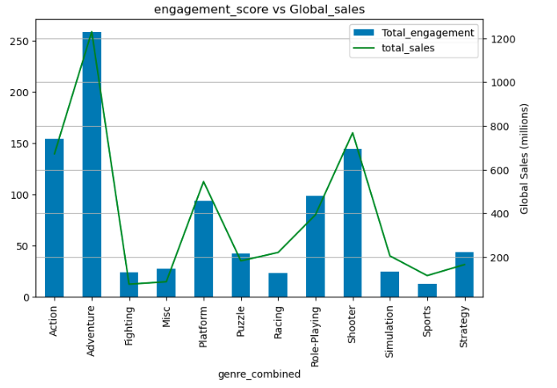
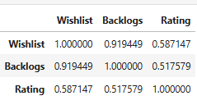
EDA Merged data (3)
26. Which genres have the highest engagement but lowest sales
27. Do highly listed games (wishlist/backlogs) correlate with better ratings?
A moderate, positive, linear relationship between two variables.
A correlation of 0.59 suggests:
Games with higher ratings tend to have more users adding them to their wishlist.
A correlation of 0.52 suggests:
Higher-rated games are more likely to appear in users’ backlogs.
Ratings have a meaningful but not dominant influence on user interest and ownership behavior.
Engagement and Sales Are Strongly Positively Correlated
Genres with higher engagement scores tend to generate higher global sales.
Adventure and Shooter lead both in engagement and sales.
Not All Engagement Converts Equally Across Genres
Some genres show moderate engagement but comparatively lower sales:
Action has strong engagement but doesn’t surpass Adventure/Shooter in sales.
Fighting, Sports, and Simulation have lower engagement and correspondingly lower sales.

Slide 20
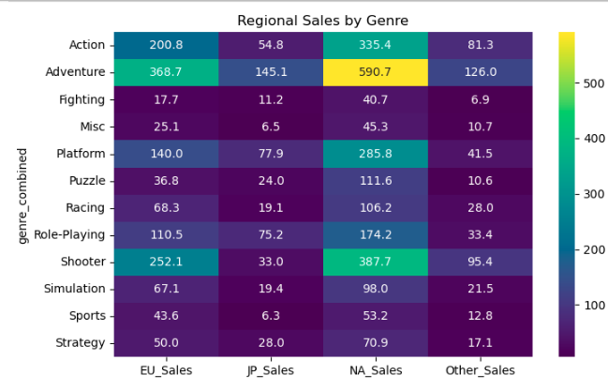
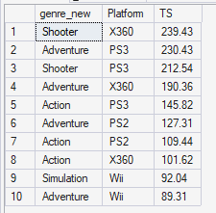
EDA Merged data (4)
30. What does a regional sales heatmap by genre reveal?
29. What are the top-performing combinations of Genre + Platform?
Overall Conclusion
NA = Primary revenue engine
EU = Similar preferences, smaller scale
JP = Distinct, RPG/adventure-oriented
Adventure is the global winner
Shooters dominate in Western markets but underperform in Japan

Slide 21
Business Insights
Genre: Action, Adventure, and Shooter genres generate the highest overall sales globally.
High-engagement genres like Adventure, Action, Shooter, Platform and RPG were leading sales.
Platforms: PS3,X360,PS2,Wii, PS platforms generate the highest overall sales
PS3, X360, PC, PS2, PS4 platforms are High in count meaning most games are using these platforms.
Though Wii is in top 4 sales but is in top 10 in count,
Rating: Ratings moderately influence wishlist and backlog growth
Ratings and wishlists show only a weak positive link to sales
Platform strength + genre appeal + regional demand determine real commercial success — not ratings alone.
Region: North America leads total sales, while Europe follows similar trends at a slightly lower scale.
Japan shows distinct preferences, particularly stronger performance in role-playing and adventure genres.
North America Drives Revenue, but Genre Strength Scales Globally
Across platforms, North America consistently contributes the largest share of sales. However, top-performing genres (Adventure, Shooter, RPG) succeed across all regions.
Year : The massive growth period (mid-1990s to 2008) aligns with dominant platforms like PS2, X360, and Wii.
At the same time, high-engagement genres like Adventure, Shooter, and RPG were leading sales.
Industry Growth Was Platform-Driven, Not Just Genre-Driven
Volume of Releases Doesn’t Guarantee Long-Term Growth
After 2008–2010: Releases remained high briefly, Sales declined sharply
At the same time, only a few genres/platforms generate the majority of revenue

